Slide 1





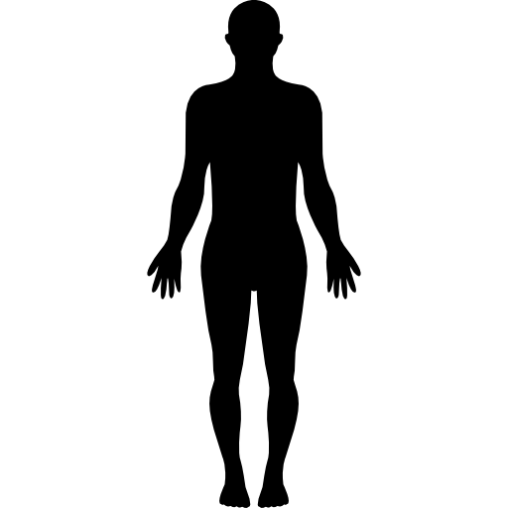


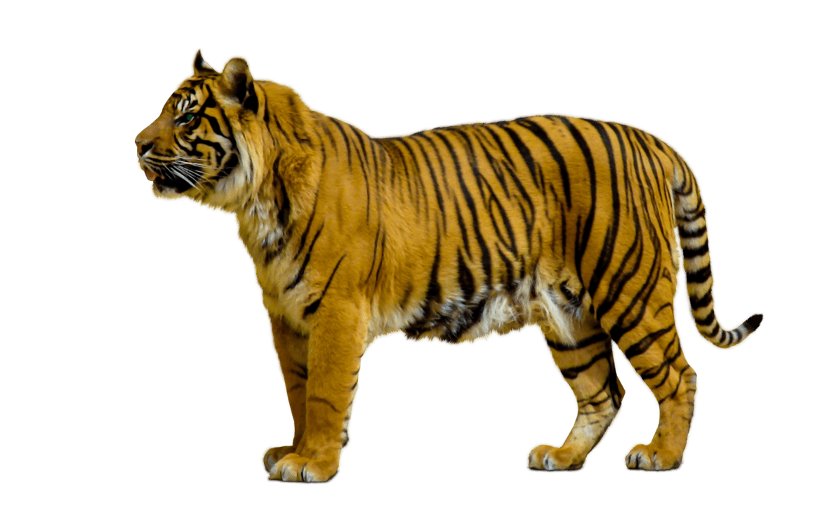
Year 6
Science
Working Scientifically
* Plan different types of scientific enquiries to answer questions, including recognising and controlling variables where necessary.
* Take measurements, using a range of scientific equipment, with increasing accuracy and precision, taking repeat readings when appropriate.
* Record data and results of increasing complexity using scientific diagrams and labels, classification keys, tables, scatter graphs, bar and line graphs.
* Use tests to make predictions to set up further comparative and fair tests.
* Report and present findings from enquiries, including conclusions, causal relationships and explanations of and degree of trust in results, in oral and written forms such as displays and other presentations.
* Identify scientific evidence that has been used to support or refute ideas or arguments.
Evolution and Inheritance
Electricity
Living things and their habitats
Light
Spring 1 (Evolution and Inheritance)
Evolution and Inheritance
Recognise that living things have changed over time and that fossils provide information about living things that inhabited the Earth millions of years ago.
Recognise that living things produce offspring of the same kind, but normally offspring vary and are not identical to their parents.
Identify how animals and plants are adapted to suit their environment in different ways and that adaptation may lead to evolution.
Autumn 1(Classifying Living Things)
Living things and their Habitats
Describe how living things are classified into broad groups according to common observable characteristics and based on similarities and differences, including micro-organisms, plants and animals
Give reasons for classifying plants and animals based on specific characteristics.
Spring 2/Summer 1 (Light and Sight)
Light
Recognise that light appears to travel in straight lines.
Explain that we see things because light travels from light sources to our eyes or from light sources to objects and then to our eye.
Use the idea that light travels in straight lines to explain that objects are seen because they give out or reflect light into the eye.
Use the idea that light travels in straight lines to explain why shadows have the same shape as the objects that cast them.
Autumn 2 (Changing Circuits)
Electricity
Associate the brightness of a lamp or the volume of a buzzer with the number and voltage of cells used in the circuit.
Compare and give reasons for variations in function, including the brightness of bulbs, the loudness of buzzers and the on/off position of switches.
Use recognised symbols when representing a simple circuit in a diagram.
Animals,
including
humans
Autumn 2 (Our Bodies)
Animals, including humans
Identify and name the main parts of the human circulatory system, and describe the functions of the heart, blood vessels and blood.
Recognise the impact of diet, exercise, drugs and lifestyle on the way their bodies function
Describe the ways in which nutrients and water are transported within animals, including humans.

