Slide 1
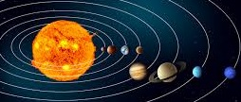
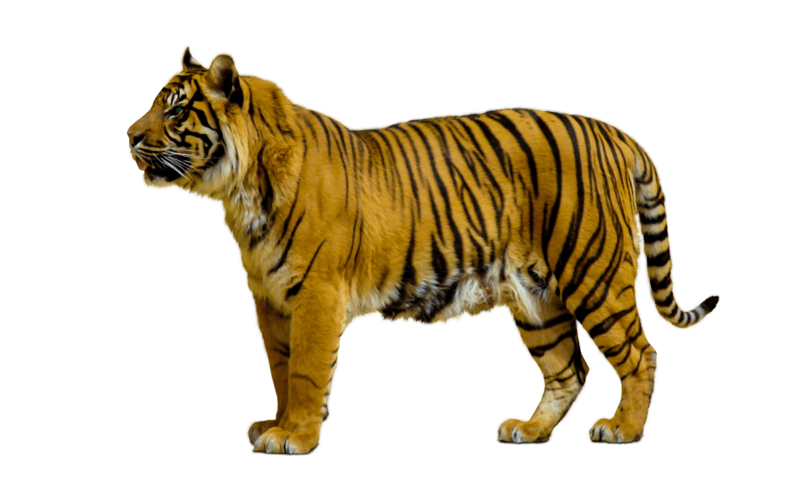
Working Scientifically
* Plan different types of scientific enquiries to answer questions, including recognising and controlling variables where necessary.
* Take measurements, using a range of scientific equipment, with increasing accuracy and precision, taking repeat readings when appropriate.
* Record data and results of increasing complexity using scientific diagrams and labels, classification keys, tables, scatter graphs, bar and line graphs.
* Use tests to make predictions to set up further comparative and fair tests.
* Report and present findings from enquiries, including conclusions, causal relationships and explanations of and degree of trust in results, in oral and written forms such as displays and other presentations.
* Identify scientific evidence that has been used to support or refute ideas or arguments.
Earth and space
Living things and their habitats
Forces
Autumn 1 (Earth and Space)
Earth and space
Describe the movement of the Earth and the other planets, relative to the Sun in the solar system.
Describe the movement of the Moon relative to the Earth.
Describe the Sun, Earth and Moon as approximately spherical bodies.
Use the idea of the Earth’s rotation to explain day and night and the apparent movement of the sun across the sky.
Year 5
Science
Spring 2 (Life Cycles)
Living things and their habitats
Describe the differences in the life cycles of a mammal, an amphibian, an insect and a bird.
Describe the life process of reproduction in some plants and animals.
Spring 2 (Life Cycles)
Animals, including humans
Describe the changes as humans develop to old age.
Autumn 2 (Forces)
Forces
Explain that unsupported objects fall towards the Earth because of the force of gravity acting between the Earth and the falling object.
Identify the effects of air resistance, water resistance and friction, that act between moving surfaces.
Recognise that some mechanisms, including levers, pulleys and gears, allow a smaller force to have a greater effect.
Summer 1 (Separating Mixtures)
Properties and changes of materials
Use knowledge of solids, liquids and gases to decide how mixtures might be separated, including through filtering, sieving and evaporating.
Know that some materials will dissolve in liquid to form a solution, and describe how to recover a substance rom a solution.
Spring 2 (Materials)
Everyday Materials
Compare and group together everyday materials on the basis of their properties, including their hardness, solubility, transparency, conductivity (electrical and thermal), and response to magnets.
Give reasons, based on evidence from comparative fair tests, for the particular uses of everyday materials, including materials, wood and plastic.
Animals,
including
humans
Properties and changes of materials
Summer 2 (Types of Change)
Properties and changes of materials
Demonstrate that dissolving, mixing and changes of state are reversible changes.
Explain that some changes result in the formation of new materials, and that this kind of change is not usually reversible, including changes associated with burning and the action of acid on bicarbonate of soda.

