Slide 1
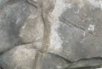



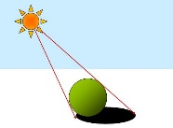



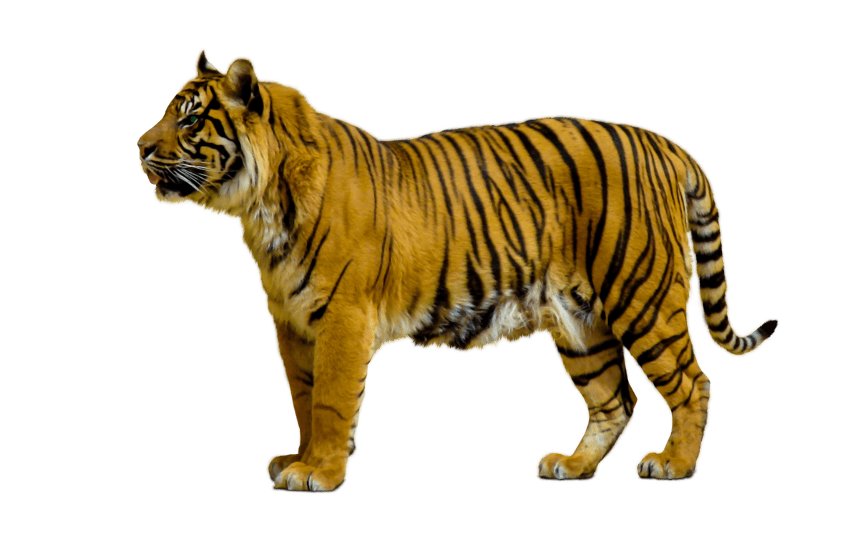

Autumn 1 (Rocks and Soils)
Rocks
Compare and group together different kinds of rocks on the basis of their appearance and simple physical properties.
Describe in simple terms how fossils are formed when things that have lived are trapped within rock.
Recognise that soils are made from rocks and organic matter.
Year 3
Science
Working Scientifically
* Ask relevant questions and use different types of scientific enquiries to answer them.
* Set up simple practical enquiries, comparative and fair tests.
* Make systematic and careful observations and, where appropriate, take accurate measurements using standard units, using a range of equipment, including thermometers and data loggers.
*Gather, record, classify and present data in a variety of ways to help with answering questions.
* Record findings using simple scientific language, drawings, labelled diagrams, keys, bar charts and tables.
* Report on findings from enquiries, including oral and written explanations, displays or presentations of results and conclusions.
* Use results to draw simple conclusions, make predictions for new values, suggest improvements and raise further questions.
* Identify differences, similarities or changes related to simple scientific ideas and processes.
*Use straightforward scientific evidence to answer questions or to support their findings.
Plants
Light
Rocks
Spring 2 (Parts of Plants)
Plants
Identify and describe the functions of different parts of flowering plants: roots, stem/trunk, leaves and flowers.
Autumn 2(Magnets and Forces)
Forces and Magnets
Compare how things move on different surfaces.
Notice that some forces need contact between two objects, but magnetic forces can act at a distance.
Observe how magnets attract or repel each other and attract some materials and not others.
Compare and group together a variety of everyday materials on the basis of whether they are attracted to a magnet, and identify some magnetic materials.
Predict whether two magnets will attract or repel each other, depending on which poles are facing. Describe magnets as having two poles.
Summer 1 (What Plants Need)
Plants
Explore and describe the requirements of plants for life and growth (air, light, water, nutrients from soil, and room to grow) and how they vary from plant to plant.
Investigate the way in which water is transported within plants.
Explore the part that flowers play in the life cycle of lowering plants, including pollination, seed formation and seed dispersal..
Summer 2 (Movement and Feeding)
Animals, including humans
Identify that animals, including humans, need the right types and amount of nutrition, and that they cannot make their own food, they get nutrition from what they eat.
Identify that humans and some other animals have skeletons and muscles for support, protection and movement.
Animals,
including
humans
Spring 1 (Light and Shadows)
Light
Recognise that they need light in order to see things and that dark is the absence of light. Notice that light is reflected from surfaces.
Recognise that light from the sun can be dangerous and that there are ways to protect eyes.
Recognise that shadows are formed when the light from a light source is blocked by a solid object.
Find patterns in the way that the size of shadows change.
Forces and Magnets

