Slide 1


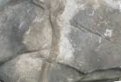
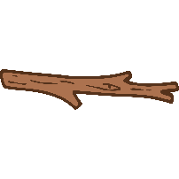





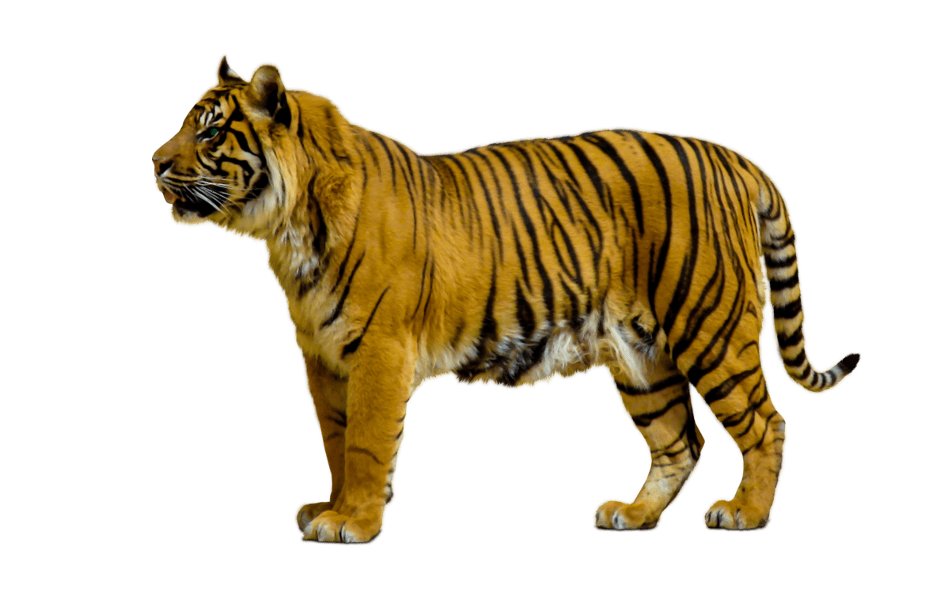

Working Scientifically
Ask simple questions and recognise that they can be answered in different ways.
Observe closely, using simple equipment.
Perform simple tests.
Identify and classify.
Use their observations and ideas to suggest answers to questions.
Gather and record data to help in answering questions.
Plants
Living things and their habitats:
Animals, including humans
Uses of everyday materials
Autumn 2 (Living Things) (Habitats)
Living things and their habitats
Explore and compare the differences between things that are living, dead, and things that have never been alive.
Identify that most living things live in habitats to which they are suited and describe how different habitats provide for the basic needs of different kinds of animals and plants, and how they depend on each other.
Identify and name a variety of plants and animals in their habitats, including micro-habitats.
Describe how animals obtain their food from plants and other animals, using the idea of a simple food chain, and identify and name different sources of food.
Year 2
Science
Autumn 1 (Feeding and Exercise)
Animals, including humans
Notice that animals, including humans, have offspring which grow into adults.
Describe the basic needs of animals, including humans, for survival (water, food, air)
Describe the importance for humans of exercise, eating the right amounts of different types of food, and hygiene.
Spring 2 (Changing Shape)
Uses of everyday materials
Find out how the shapes of solid objects made from some materials can be changed by squashing, bending, twisting and stretching.
Spring 1 (Growing Plants)
Plants
Observe and describe how seeds and bulbs grow into mature plants.
Find out and describe how plants need water, light and a suitable temperature to grow and stay healthy.
Summer 2 (Uses of Materials)
Uses of everyday materials
Identify and compare the suitability of a variety of everyday materials, including wood, metal, plastic, glass, brick, rock, paper and cardboard for particular uses.
No Summer 1
SATs

