Slide 1
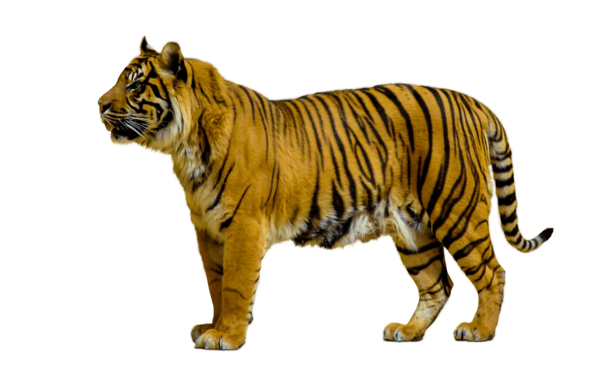
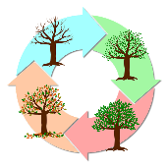
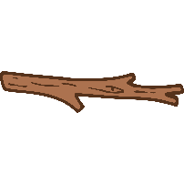
Working Scientifically
Ask simple questions and recognise that they can be answered in different ways.
Observe closely, using simple equipment.
Perform simple tests.
Identify and classify.
Use their observations and ideas to suggest answers to questions.
Gather and record data to help in answering questions.
Plants
Seasonal changes
Animals, including humans
Everyday materials
Year 1
Science
Spring 2 (Types of Animals)
Animals, including humans
Identify and name a variety of common animals that are carnivores, herbivores and omnivores.
Describe and compare the structure of a variety of common animals (fish, amphibians, reptiles, birds and mammals)
Autumn 1 (Parts of Animals)
Animals, including humans
Identify, name, draw and label the basic parts of the human body and say which part of the body is associated with each sense.
Describe and compare the structure of a variety of common animals (fish, amphibians, reptiles, birds and mammals including pets).
Summer 1 (Plants)
Plants
Identify and name a variety of common wild and garden plants, including deciduous and evergreen trees.
Identify and describe the basic structure of a variety of common flowering plants, including trees.
Autumn 2 (Changing Seasons)
Seasonal changes
Observe changes across the 4 seasons.
Observe and describe weather associated with the seasons and how day length varies.
Spring 1 (Identifying Materials)
Everyday materials
Distinguish between an object and the material from which it is made.
Identify and name a variety of everyday materials, including wood, plastic, glass, metal, water, and rock.
Summer 2 (Comparing Materials)
Everyday materials
Describe the simple physical properties of a variety of everyday materials.
Compare and group together a variety of everyday materials on the basis of their simple physical properties.

