Slide 1
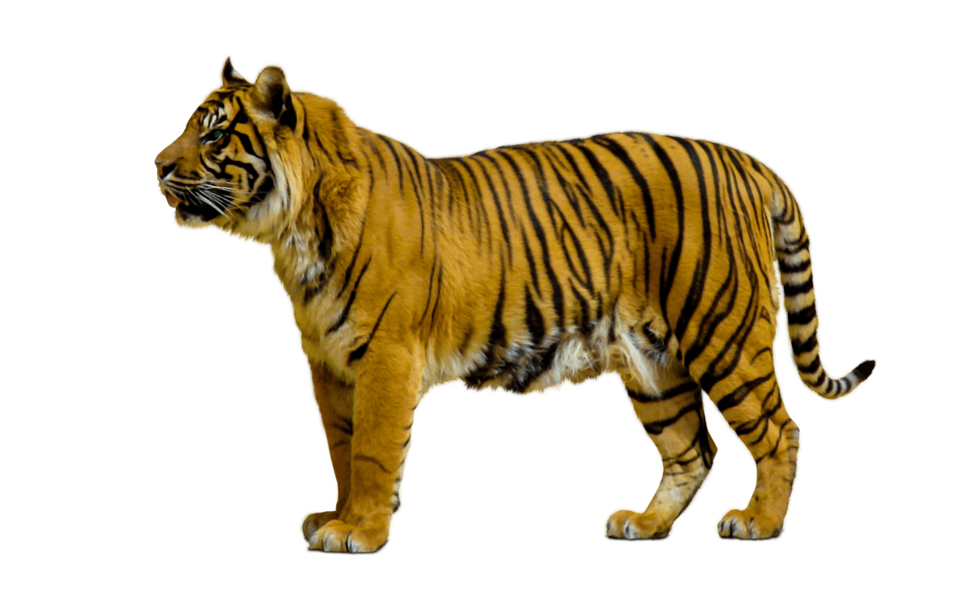
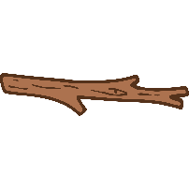
Science
Rocks
Rocks and Soils (Y3)
Working Scientifically
See year group overviews
Evolution and Inheritance
Electricity
Living things and their habitats
Light
Seasonal changes
Y1
Earth and space
Rocks
Y3
Y4, Y6
Electricity
Electricity (Y4)
Changing Circuits (Y6)
Living things and their Habitats
Living Things (Y2)
Habitats (Y2)
Grouping Living Things (Y4)
Dangers to Living Things (Y4)
Life Cycles (Y5)
Classifying Living Things (Y6)
Y2, Y4, Y5, Y6
Forces and
Magnets
Forces and Magnets
Magnets and Forces (Y3)
Forces (Y5)
Y5
States of Matter & Properties and changes of materials
Y3, Y5
Earth and Space
Earth and Space (Y5)
Seasonal Changes
Changing seasons (Y1)
States of Matter/ Changes of materials
Changes of State (Y4)
Types of Change (Y5)
Separating Mixtures (Y5)
Y4, Y5
Animals,
including
humans
Animals, including humans
Parts of Animals (Y1)
Types of Animals (Y1)
Feeding and Exercise (Y2)
Movement and Feeding (Y3)
Human Nutrition (Y4)
Life Cycles (Y5)
Our bodies (Y6)
Everyday
Materials
Everyday Materials
Identifying Materials (Y1)
Comparing Materials (Y1)
Changing shape (Y2)
Uses of Materials (Y2)
Materials (Y5)
Y1, Y2, Y3, Y4, Y5, Y6
Y1, Y2, Y5
Evolution and Inheritance
Evolution (Y6)
Plants
Sound
Sound (Y4)
Sound
Y3, Y6
Y1, Y2, Y3
Plants
Plants (Y1)
Growing Plants (Y2)
Parts of Plants (Y3)
What Plants Need (Y3)
Y4
Y6
Light
Light and shadow (Y3)
Light and Sight (Y6)

