Slide 1
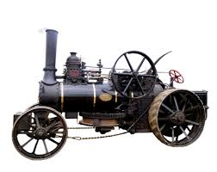
The achievements of the earliest civilisation- an overview of where and when the first civilizations appeared and a depth study of Ancient Egypt.
Describe the achievements of the earliest civilians.
Describe a chronologically secure knowledge and understanding of world history, establishing clear narratives within and across the periods he/she studies.
Note connections, contrasts and trends over time to show developing appropriate use of historical terms.
Use evidence to support arguments.
A study of an aspect or theme in British history that extends pupils chronological knowledge beyond 1066.
Describe a chronologically secure knowledge and understanding of British history, establishing clear narratives within and across the periods he/she studies.
Address and sometimes devise historically valid questions about change, cause, similarity and difference and significance.
Understand how our knowledge of the past is constructed from a range of sources.
Make confident use of a variety of sources for independent research.
Summer 1
Ancient Egypt
Industrial Revolution - Victorian
1784-2020
6000-51 BC
1784-2020
The Growth of Teesside.
A study of an aspect or theme in British history – growth of Teesside
Describe a chronologically secure knowledge and understanding of British, local and world history, establishing clear narratives within and across the periods he/she studies.
past.
Address ad sometimes devise historically valid questions about change, cause, similarity and difference and significance.
Understand how our knowledge of the past is constructed from a range of sources.
Autumn 1
Summer 2
History
Year 6

