Slide 1
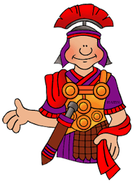
Pupils should be taught about changes in Britain from the Stone Age to the Iron Age
To describe changes in Britain from the Stone
Age to the Iron Age.
Use an increasing range of common words and phrases relating to the passage of time.
Teaching may include:
Creating a timeline to show this period of time.
Understanding how Stone Age hunters gathered food and how shelters were made.
Recognise how archaeologists help to uncover
the past.
How Stone Age people made tools and jewellery.
To study an aspect or theme in British History that extends pupils chronological knowledge beyond 1066
Use an increasing range of common words and phrases relating to the passage of time.
Teaching may include:
Crime and punishment in Roman times.
The Anglo-Saxon legal system.
Vagrancy and treason in the Tudor times.
Research and discuss Dick Turpin.
Look at Robert Peel and the introduction of the Police force.
Spring 1
Stone Age to Iron Age
700 BC -475 AD
Crime and Punishment
500 – 332 BC
800-2021
The Romans and their impact on Britain.
Pupils should be taught about The Roman Empire and its impact on Britain.
A Local History Study.
Use an increasing range of common words and phrases relating to the passage of time.
Describe the Roman Empire and its impact on Britain.
Teaching may include:
Understanding what it was like to be a Celt prior Roman invasion.
Research ‘Boudicca’ and learn about her life.
How were the Romans able to defeat the Celts and what did the Romans bring to Britain.
Summer 1
History
Year 3
Autumn 1

