Slide 1
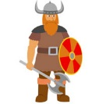
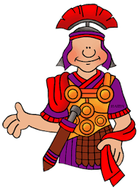
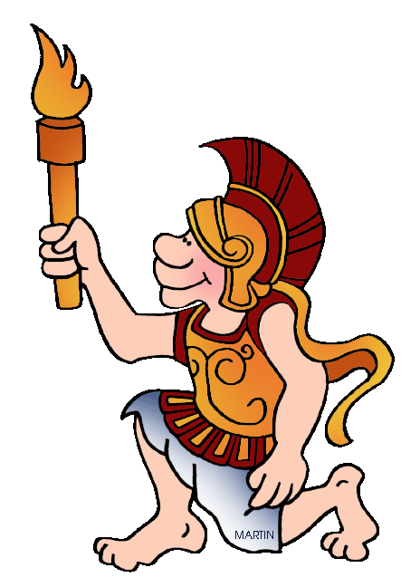
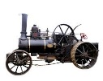
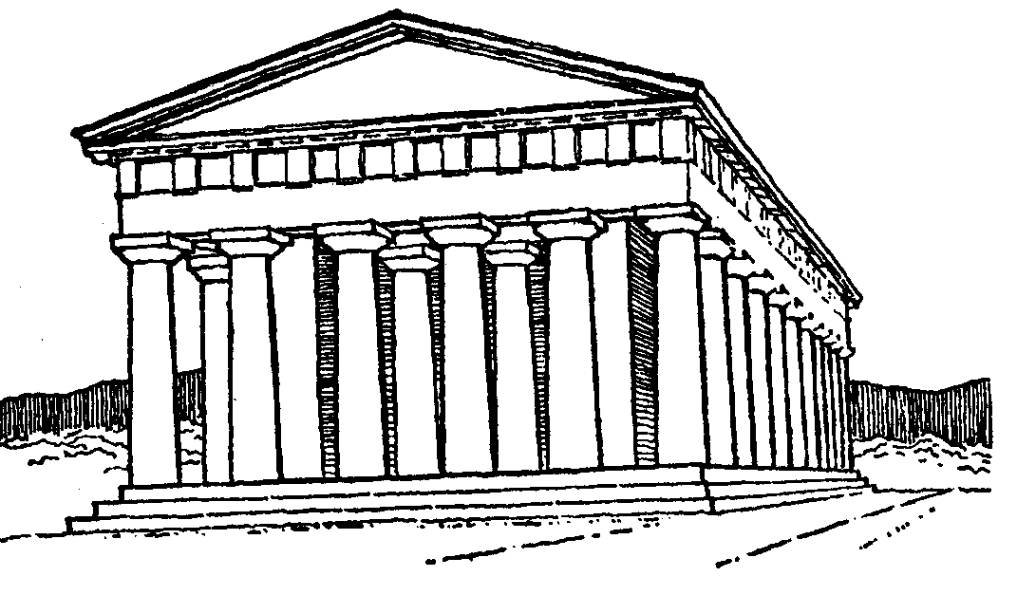
Curriculum Timeline
Year 6
Year 5
A.Saxons
Vikings
Year 3
Year 1
Year 2
Year 1
Egyptians
Romans
Christopher Columbus
Capt Cook
Toys through history
6000-51 BC
600 BC-1066 AD
700 BC - 475 AD
1451-1506
1728-1779
1940-1960
800-323 BC
500 – 332 BC
900 AD
1666
1784-2020
1939-1945
Stone Age
Mayans
Gt Fire of Londaon
Industrial
Revolution/Victorians
Greeks
WW 2
Year 5
Year 3
Year 4
Year 2
Year 4
Year 6
A local History Study
The use of Ancient
Greek ideas today.
Travel and Transport
Crime and Punishment
The Growth of
Teesside.
Refugees during
the war
Our Local History
800-2020
800-2020
323 BC-2020
1784-2020
1939-1945
1910-2021
Year 2
Year 3
Year 5
Year 6
Year 1
Year 4

