Slide 1
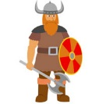
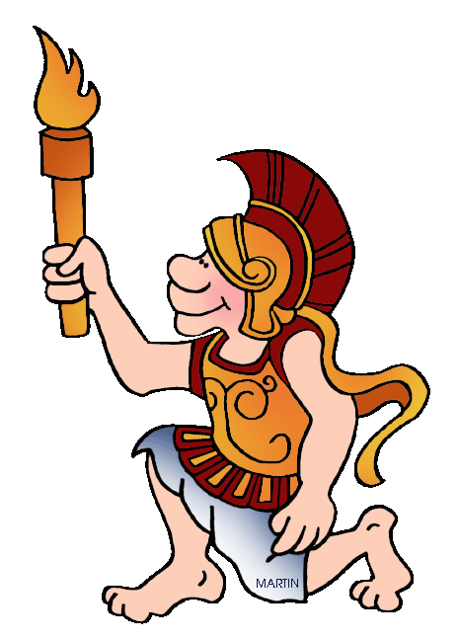
The achievements of the earliest civilisation- an overview of where and when the first civilizations appeared and a depth study of Ancient Egypt.
Use dates to order place events on a timeline.
Understand that the type of information available depends on the period of time studied.
Evaluate the usefulness of a variety of sources.
Give some reasons for some important historical events.
Describe a study of Ancient Greek life and achievements and their influence on the western world.
Present findings and communicate knowledge and understanding in different ways.
A study of an aspect or theme in British history that extends pupils chronological knowledge beyond 1066.
the legacy of Greek or Roman culture (art, architecture or literature) on later periods in British history, including the present day
Make comparisons between aspects of periods of history and the present day.
Use dates to order place events on a timeline
Describe a study of Ancient Greek life and achievements and their influence on the western world.
Compare sources of information available for the study of different times in the past.
Present findings and communicate knowledge and understanding in different ways.
Summer 1
How do we use Ancient Greek ideas in our lives today?
Ancient Greek
600 BC-1066 AD
800-323 BC
323 BC - 2020
Anglo Saxons/Viking
A study of an aspect or theme in British history
Use dates to order place events on a timeline.
Understand that the type of information available depends on the period of time studied.
Describe Britain's settlement by Anglo-Saxons and Scots
Describe the Viking and Anglo-Saxon struggle for the Kingdom of England to the time of Edward the Confessor.
Provide an account of a historical event based on more than one source.
Compare sources of information available for the study of different times in the past.
Summer 2
Autumn 1
History
Year 5

